Slide 1
Hypothesis testing
1. Introducing H0 and H1

Slide 2

Random sample
Statistical model
$$X\sim N\left(?,?\right)$$
Confidence interval
Use the random sample to estimate the “?” by an interval [ , ]
E.g., Using a random sample and a 90% CI, we estimate the average # of steps that a NTU student takes per day is between [4767.383,5232.617] steps

Slide 3
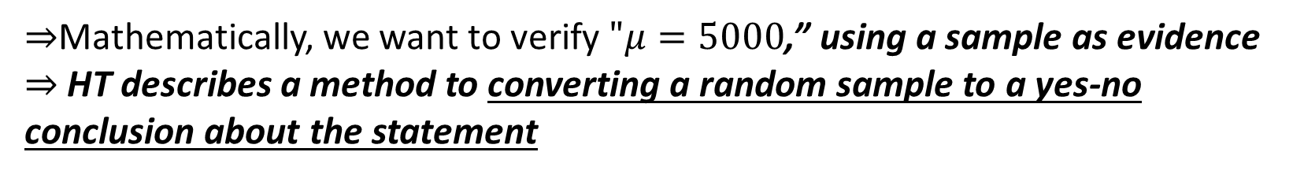
Random sample
Statistical model
$$X\sim N\left(?,?\right)$$
2. Hypothesis testing (HT)
Use the random sample to test a statement (H0) about the value of “?”
Let me test whether “the average # of steps that a NTU student takes is equal to 5000” is plausible or not
$⇒$Mathematically, we want to verify $"μ=5000$,” using a sample as evidence
$⇒$ HT describes a method to converting a random sample to a yes-no conclusion about the statement

Slide 4

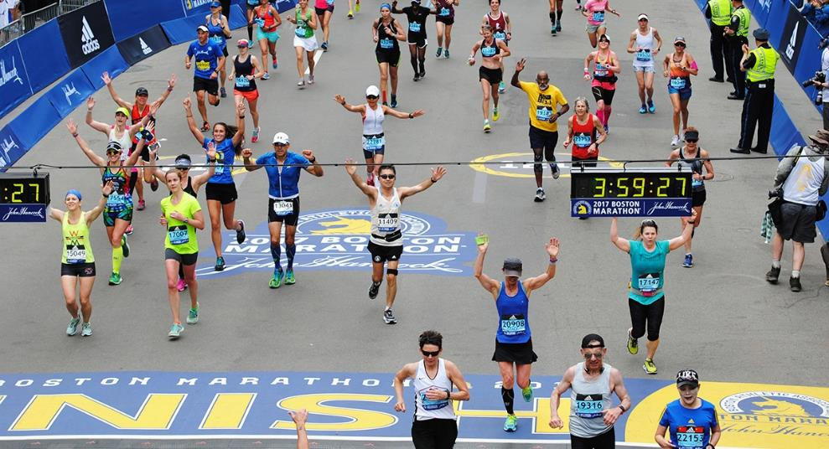
Boston marathon
The average finishing time is 3.97 hours, based on real data from the 2017 race (data file in course website)

Slide 5
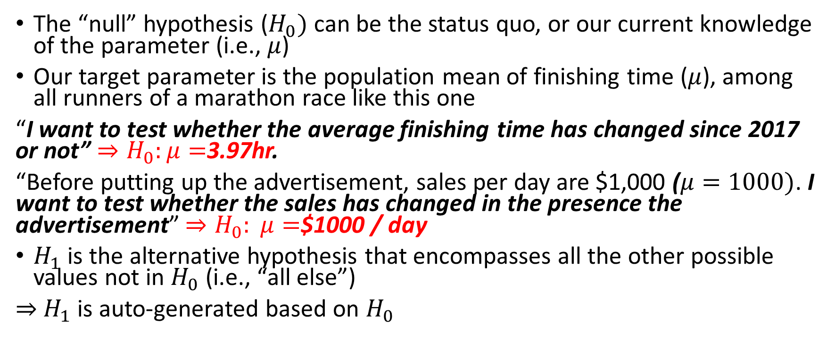

Understand $H_{0}$ and $H_{1}$
The “null” hypothesis ($H_{0})$ can be the status quo, or our current knowledge of the parameter (i.e., $μ$)
Our target parameter is the population mean of finishing time ($μ$), among all runners of a marathon race like this one
“I want to test whether the average finishing time has changed since 2017 or not” ${⇒H}_{0}:μ=$3.97hr.
“Before putting up the advertisement, sales per day are $1,000 ($μ=1000)$. I want to test whether the sales has changed in the presence the advertisement” ${⇒H}_{0}: μ=$$1000 / day
$H_{1}$ is the alternative hypothesis that encompasses all the other possible values not in $H_{0}$ (i.e., “all else”)
$⇒$ $H_{1}$ is auto-generated based on $H_{0}$

Slide 6
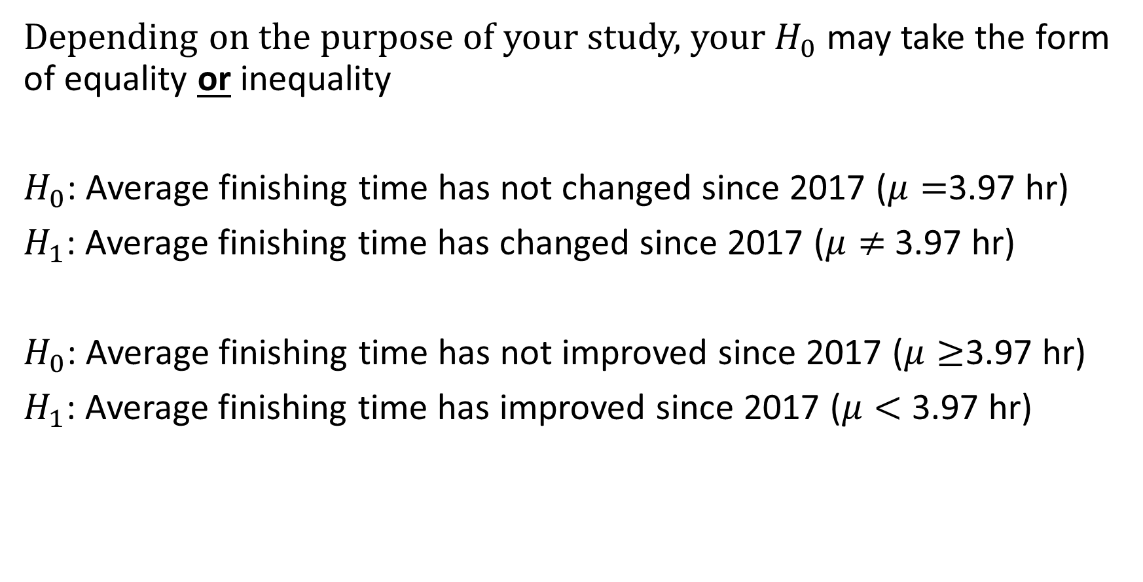

Two types of $H_{0}$
Depending on the purpose of your study, your $H_{0}$ may take the form of equality or inequality
$H_{0}$: Average finishing time has not changed since 2017 ($μ=$3.97 hr)
$H_{1}$: Average finishing time has changed since 2017 ($μ≠$ 3.97 hr)
$H_{0}$: Average finishing time has not improved since 2017 ($μ≥$3.97 hr)
$H_{1}$: Average finishing time has improved since 2017 ($μ<$ 3.97 hr)

Slide 7
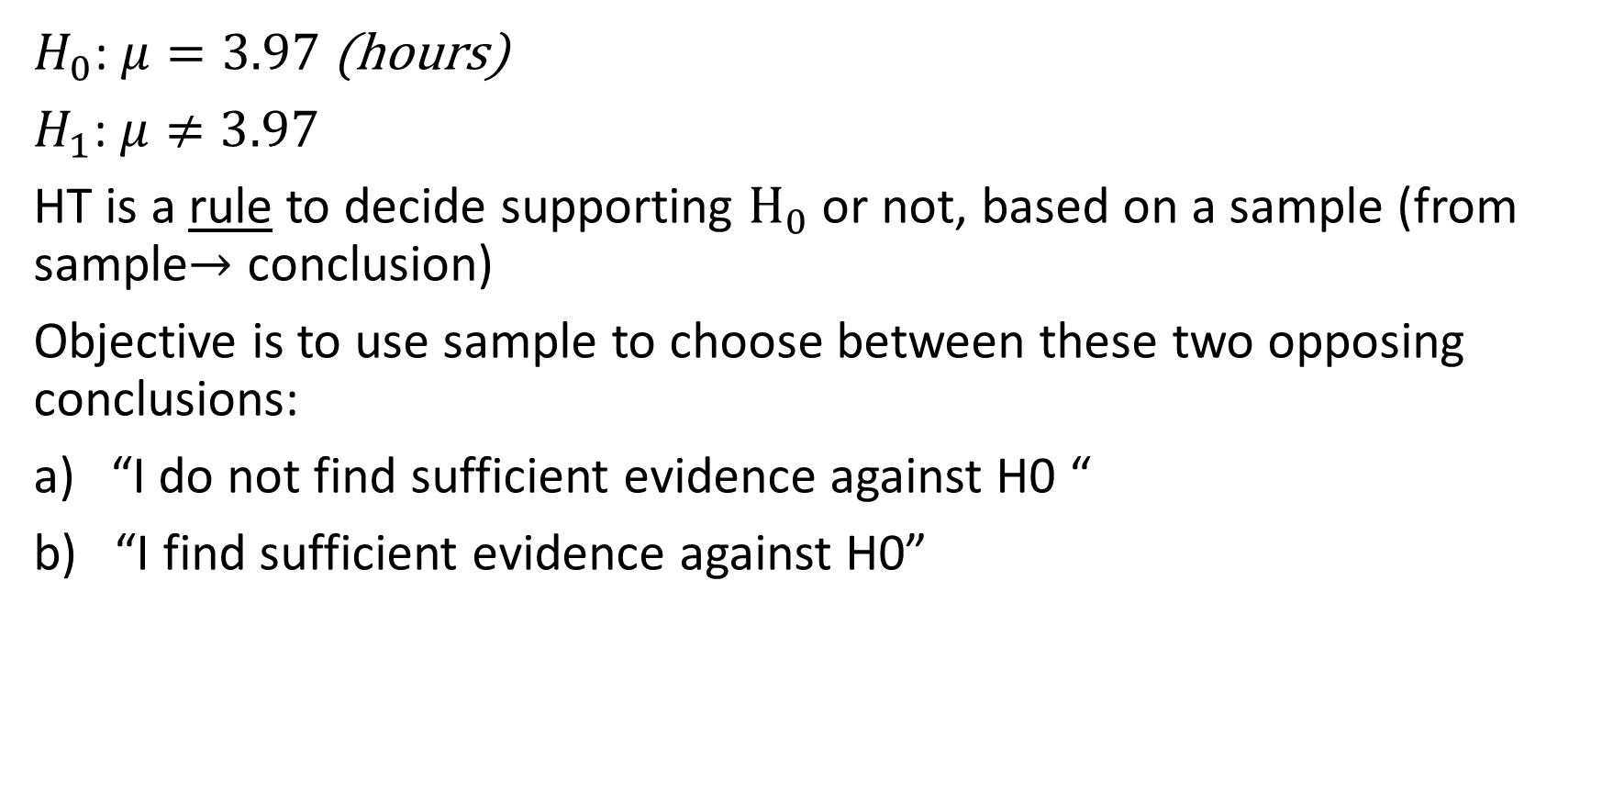
Hypothesis testing (HT): key concept 1
$H_{0}$: $μ=3.97$ (hours)
$H_{1}$: $μ≠3.97$
HT is a rule to decide supporting $H_{0}$ or not, based on a sample (from sample$→$ conclusion)
Objective is to use sample to choose between these two opposing conclusions:
“I do not find sufficient evidence against H0 “
b) “I find sufficient evidence against H0”

Slide 8

Hypothesis testing (HT): key concept 2
$H_{0}$: $μ=3.97 hr H_{1}$: $μ≠$3.97
To decide a) or b), I collected a random sample of 50 runners of the 2019 marathon ($X_{1},X_{2},..X_{50})$. Sample mean is 4.0 hours.
Since 4.0 is different from 3.97, is it right to reject $H_{0}$? If not, why not?
A: Reject H0
B: Not Reject

Slide 9
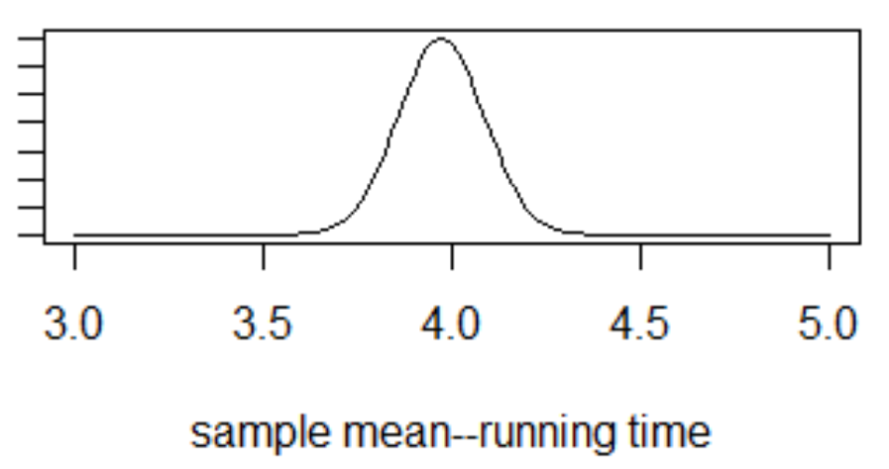
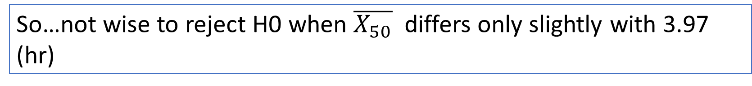

Let’s analyze this ☺
When H0 is true and $μ=3.97$ (which we don’t know is true or not)
My evidence: the sample mean of 50 runners may take this form (by CLT):
(given $μ=3.97$, by CLT)
Sample mean could deviate from 3.97 even when H0 is true—this distribution or uncertainty is due to “sampling” (instead of a census)
So…not wise to reject H0 when $\overline{X_{50}}$ differs only slightly with 3.97 (hr)

Slide 10
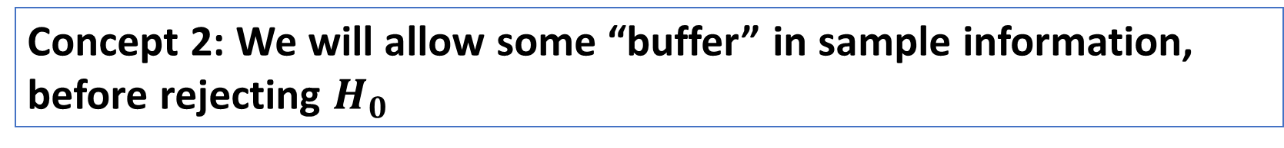


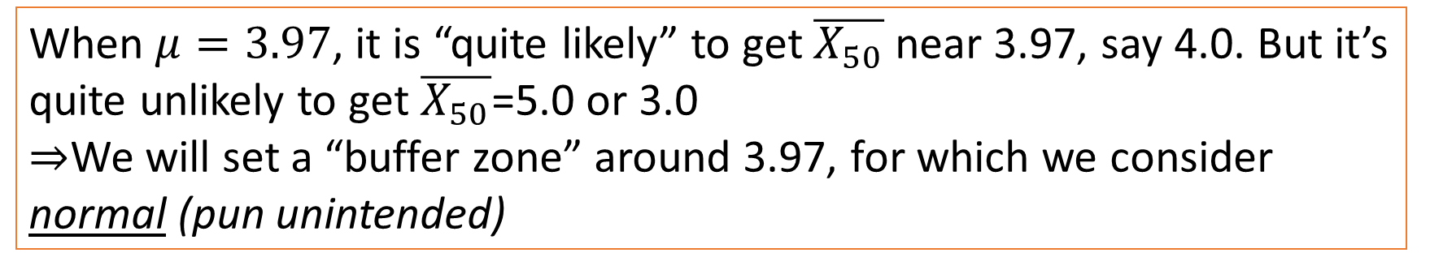
Hypothesis testing (HT): key concept 2
$H_{0}$: $μ=3.97$
$H_{1}$: $μ≠3.97$
(given $μ=3.97$, by CLT)
When $μ=3.97$, it is “quite likely” to get $\overline{X_{50}}$ near 3.97, say 4.0. But it’s quite unlikely to get $\overline{X_{50}}$=5.0 or 3.0
$⇒$We will set a “buffer zone” around 3.97, for which we consider normal (pun unintended)
Concept 2: We will allow some “buffer” in sample information, before rejecting $H_{0}$

Slide 11
Summary of hypothesis testing
Analyse the problem and formulate H0 and H1
- H0: Null hypothesis (no change; no effect). H1: Alternative hypothesis (there is a change, or an effect on status quo)
Key concept #1:
We use the sample, either to reject H0, or NOT reject H0
Key concept #2:
The sampling process induces uncertainty -> Rationally, we create a “buffer” in making the rejection decision

